Slide 1
Summary of Periodic Trends
Notes:
Objectives:
To predict a physical property for an element given the values of other elements in the same group.
To predict a chemical formula for a compound given the formulas of other compounds containing an element in the same group.

Slide 2
Metallic Characteristics
metallic character increases
nonmetallic character increases
metallic character increases
nonmetallic character increases
Notes:
• Elements with the highest ionization energies are those with the most negative electron affinities, which are located in the upper-right corner of the periodic table.
• Elements with the lowest ionization energies are those with the least negative electron affinities and are located in the lower-left corner of the periodic table.
• The tendency of an element to gain or lose electrons is important in determining its chemistry.
• Various methods have been developed to describe this tendency quantitatively.
• The most important method is called electronegativity (χ), defined as the relative ability of an atom to attract electrons to itself in a chemical compound.

Slide 3
Metallic Characteristic
metallic character increases
nonmetallic character increases
metallic character increases
nonmetallic character increases

Slide 4
Summary of Periodic Trends
Shielding is constant
Atomic radius decreases
Ionization energy increases
Electronegativity increases
Nuclear charge increases
Nuclear charge increases
Shielding increases
Atomic radius increases
Ionic size increases
Ionization energy decreases
Electronegativity decreases
1A
0
2A
3A
4A
5A
6A
7A
Ionic size (cations) Ionic size (anions)
decreases decreases
Notes:
• Elements with the highest ionization energies are those with the most negative electron affinities, which are located in the upper-right corner of the periodic table.
• Elements with the lowest ionization energies are those with the least negative electron affinities and are located in the lower-left corner of the periodic table.
• The tendency of an element to gain or lose electrons is important in determining its chemistry.
• Various methods have been developed to describe this tendency quantitatively.
• The most important method is called electronegativity (χ), defined as the relative ability of an atom to attract electrons to itself in a chemical compound.
Rules for assigning oxidation states are based on the relative electronegativities of the elements — the more-electronegative element in a binary compound is assigned a negative oxidation state
Electronegativity values used to predict bond energies, bond polarities, and the kinds of reactions that compounds undergo
Trends in periodic properties:
1. Atomic radii decrease from lower left to upper right in the periodic table.
2. Ionization energies become more positive, electron affinities become more negative, and electronegativities increase from the lower left to the upper right.

Slide 5
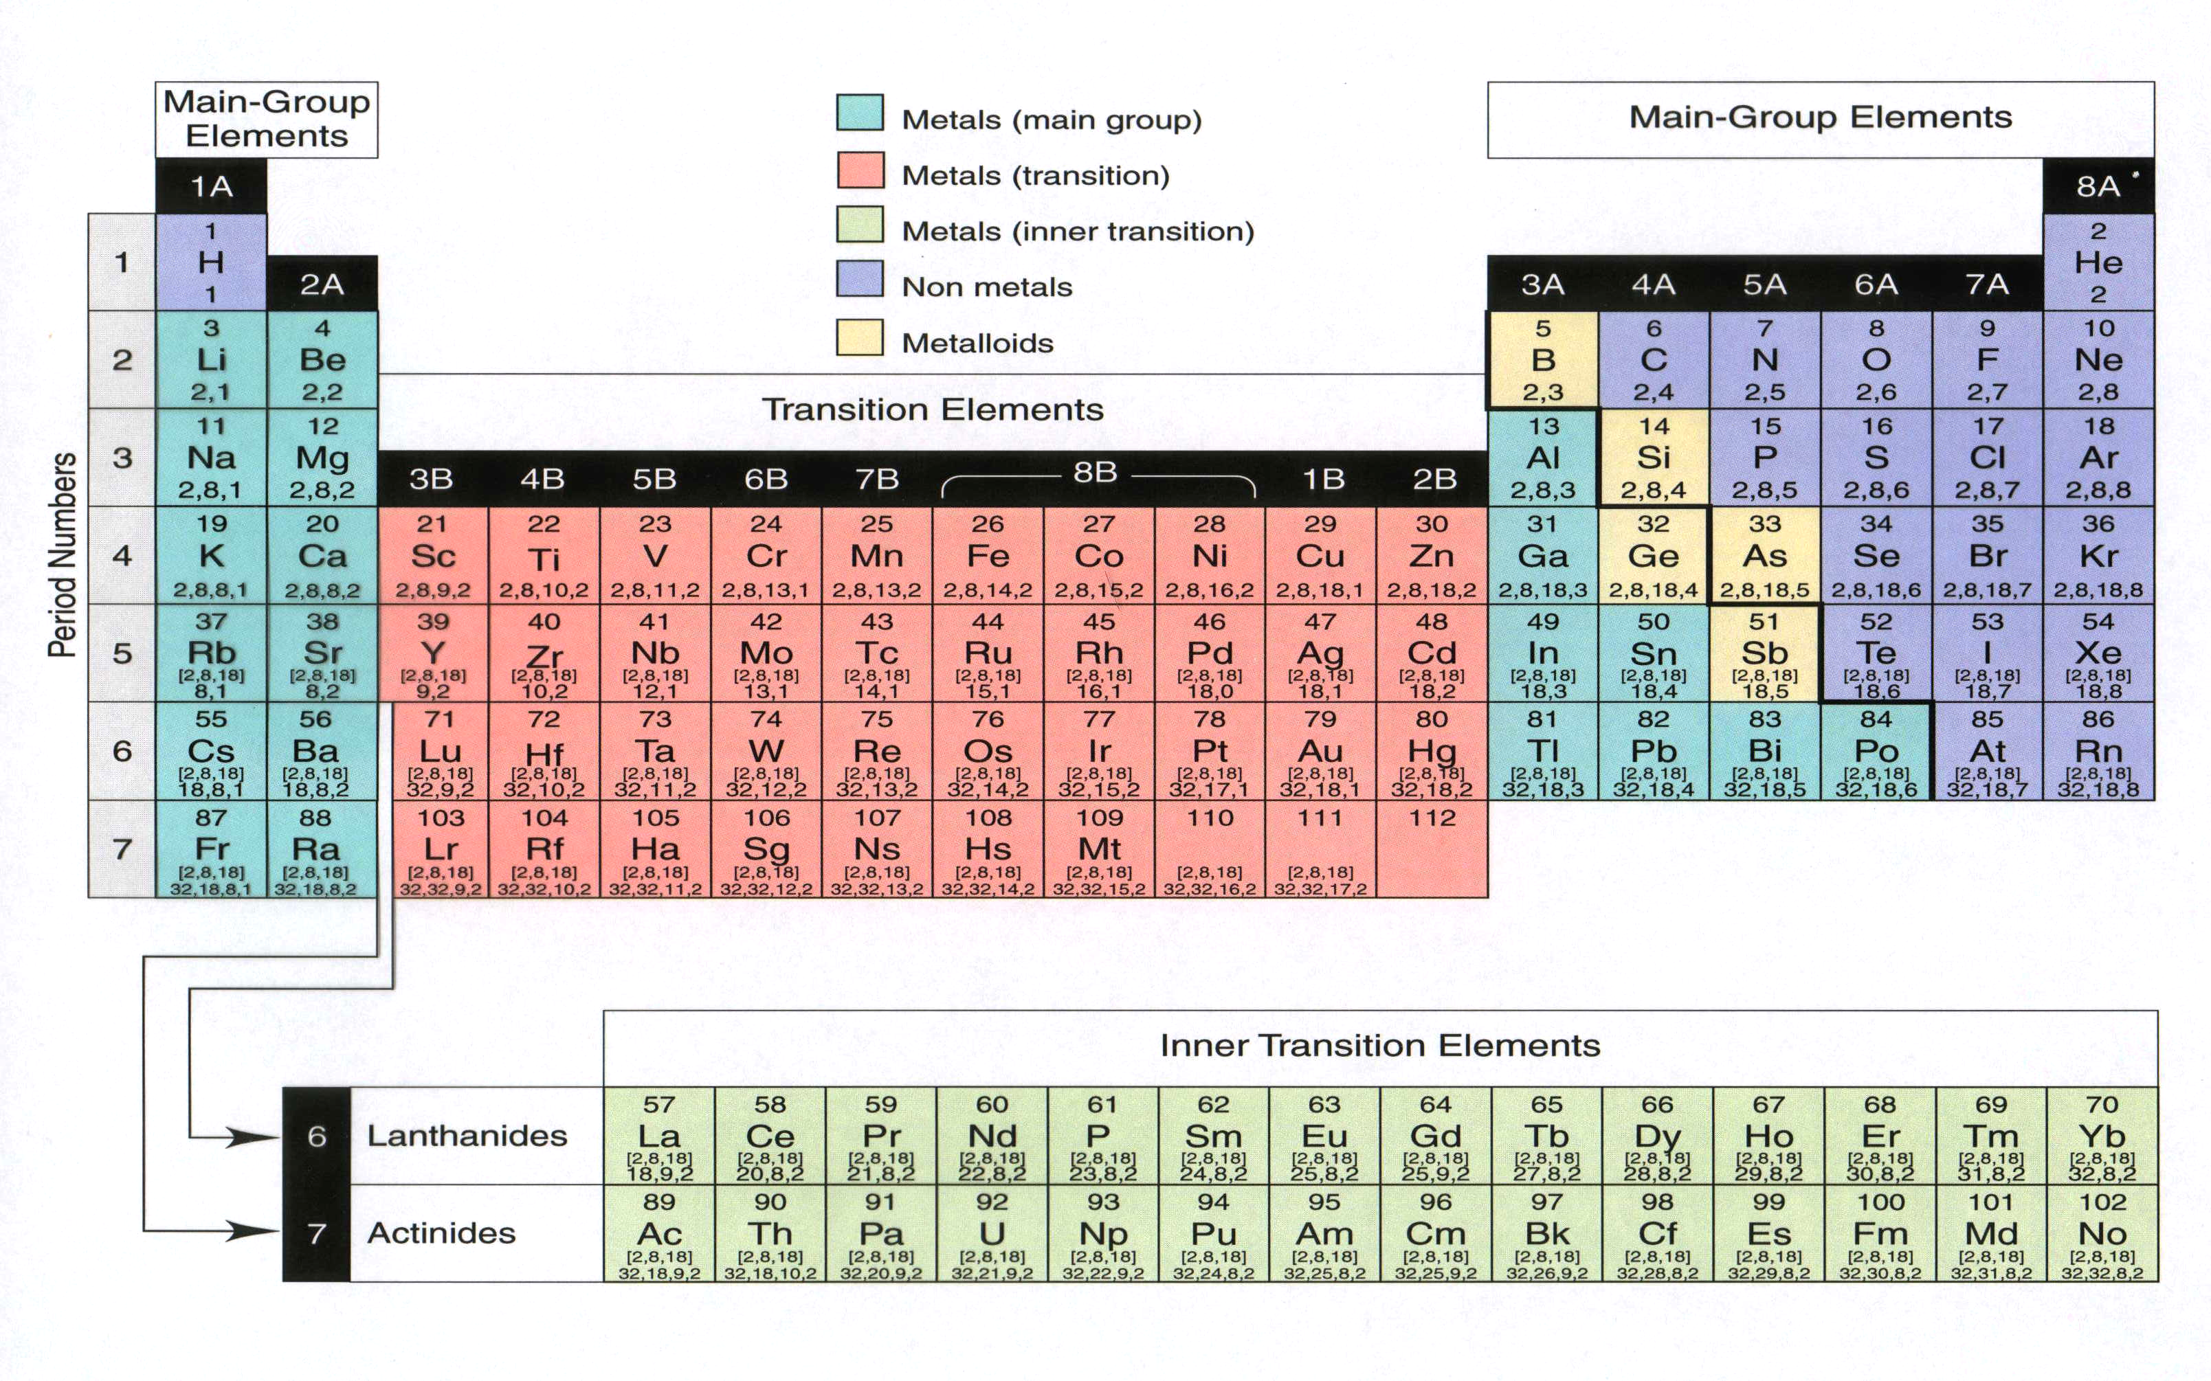
Modern Periodic Table

